Slide 1
William Stallings
Data and Computer Communications
7th Edition
Chapter 15
Local Area Network Overview

Slide 2
LAN Applications (1)
Personal computer LANs
  Low cost
  Limited data rate
Back end networks
  Interconnecting large systems (mainframes and large storage devices)
    High data rate
    High speed interface
    Distributed access
    Limited distance
    Limited number of devices

Slide 3
LAN Applications (2)
Storage Area Networks
  Separate network handling storage needs
  Detaches storage tasks from specific servers
  Shared storage facility across high-speed network
  Hard disks, tape libraries, CD arrays
  Improved client-server storage access
  Direct storage to storage communication for backup
High speed office networks
  Desktop image processing
  High capacity local storage
Backbone LANs
  Interconnect low speed local LANs
  Reliability
  Capacity
  Cost

Slide 4
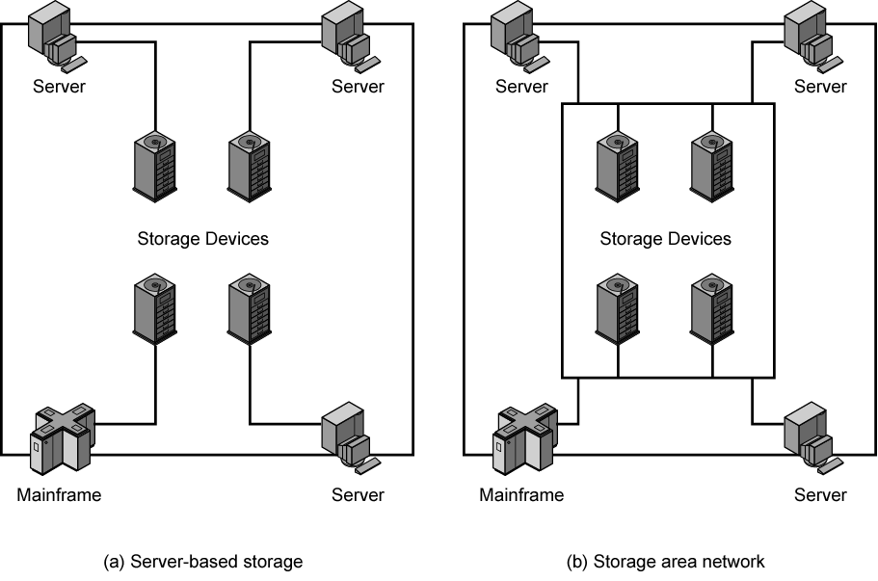
Storage Area Networks

Slide 5
LAN Architecture
Topologies
Transmission medium
Layout
Medium access control

Slide 6
Topologies
Tree
Bus
  Special case of tree
    One trunk, no branches
Ring
Star

Slide 7
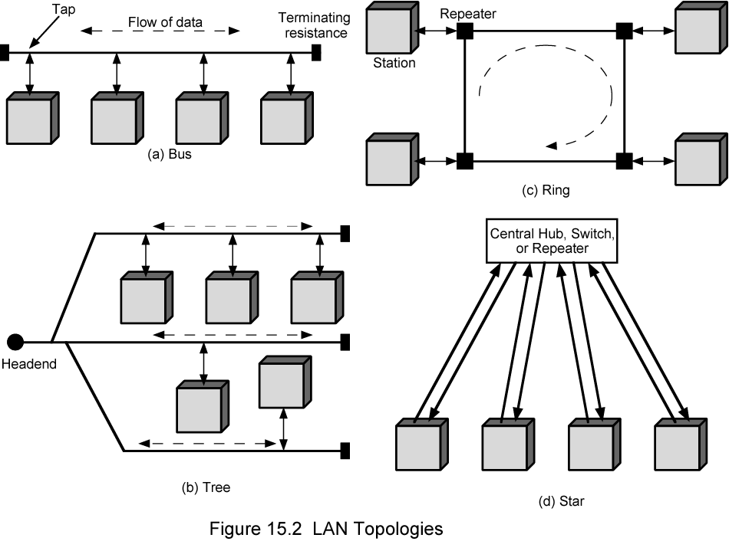
LAN Topologies

Slide 8
Bus and Tree
Multipoint medium
Transmission propagates throughout medium
Heard by all stations
  Need to identify target station
    Each station has unique address
Full duplex connection between station and tap
  Allows for transmission and reception
Need to regulate transmission
  To avoid collisions
  To avoid hogging
    Data in small blocks - frames
Terminator absorbs frames at end of medium

Slide 9
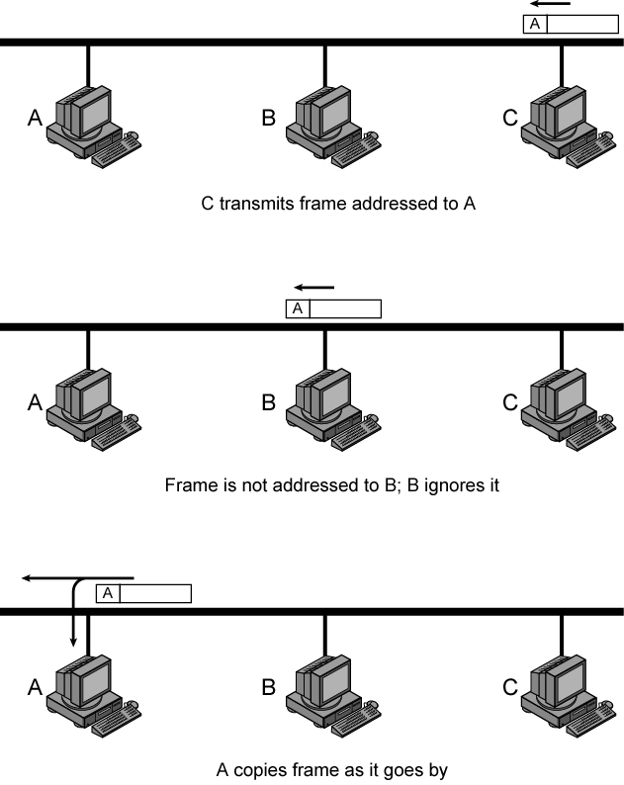
Frame
Transmission on Bus LAN

Slide 10
Ring Topology
Repeaters joined by point to point links in closed loop
  Receive data on one link and retransmit on another
  Links unidirectional
  Stations attach to repeaters
Data in frames
  Circulate past all stations
  Destination recognizes address and copies frame
  Frame circulates back to source where it is removed
Media access control determines when station can insert frame

Slide 11
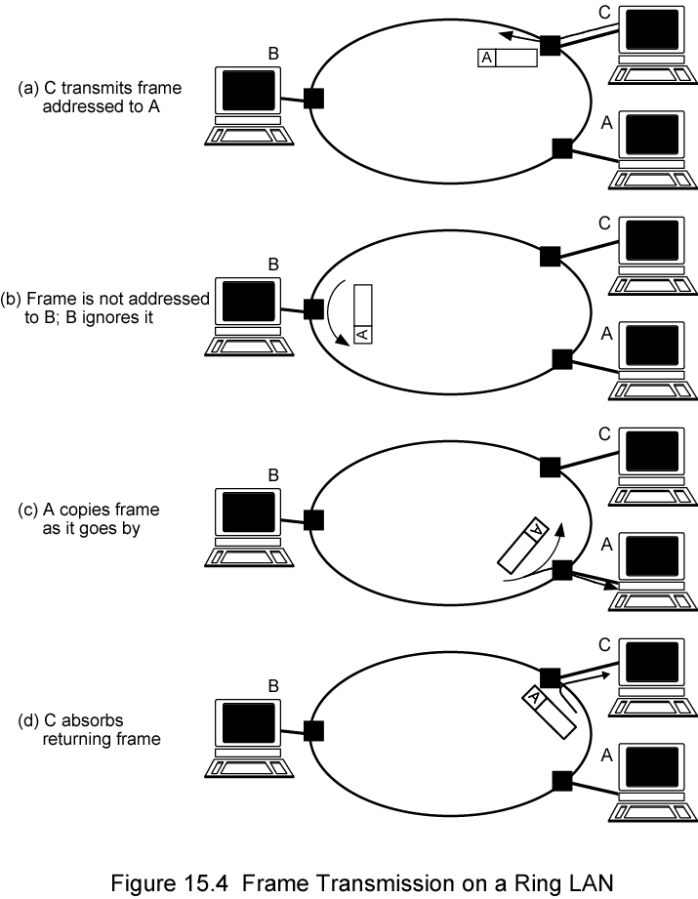
Frame
Transmission
Ring LAN

Slide 12
Star Topology
Each station connected directly to central node
  Usually via two point to point links
Central node can broadcast
  Physical star, logical bus
  Only one station can transmit at a time
Central node can act as frame switch

Slide 13
Choice of Topology
Reliability
Expandability
Performance
Needs considering in context of:
  Medium
  Wiring layout
  Access control

Slide 14
Bus LAN
Transmission Media (1)
Twisted pair
  Early LANs used voice grade cable
  Didn’t scale for fast LANs
  Not used in bus LANs now
Baseband coaxial cable
  Uses digital signalling
  Original Ethernet

Slide 15
Bus LAN
Transmission Media (2)
Broadband coaxial cable
  As in cable TV systems
  Analog signals at radio frequencies
  Expensive, hard to install and maintain
  No longer used in LANs
Optical fiber
  Expensive taps
  Better alternatives available
  Not used in bus LANs
All hard to work with compared with star topology twisted pair
Coaxial baseband still used but not often in new installations

Slide 16
Ring and Star Usage
Ring
  Very high speed links over long distances
  Single link or repeater failure disables network
Star
  Uses natural layout of wiring in building
  Best for short distances
  High data rates for small number of devices

Slide 17
Choice of Medium
Constrained by LAN topology
Capacity
Reliability
Types of data supported
Environmental scope

Slide 18
Media Available (1)
Voice grade unshielded twisted pair (UTP)
  Cat 3
  Cheap
  Well understood
  Use existing telephone wiring in office building
  Low data rates
Shielded twisted pair and baseband coaxial
  More expensive than UTP but higher data rates
Broadband cable
  Still more expensive and higher data rate

Slide 19
Media Available (2)
High performance UTP
  Cat 5 and above
  High data rate for small number of devices
  Switched star topology for large installations
Optical fiber
  Electromagnetic isolation
  High capacity
  Small size
  High cost of components
  High skill needed to install and maintain
    Prices are coming down as demand and product range increases

Slide 20
Protocol Architecture
Lower layers of OSI model
IEEE 802 reference model
Physical
Logical link control (LLC)
Media access control (MAC)

Slide 21
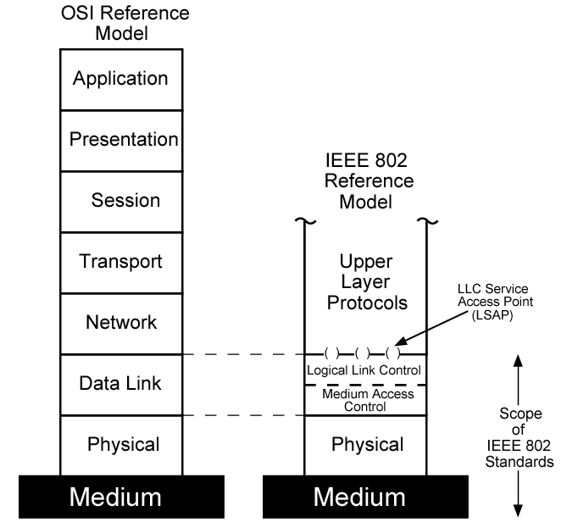
IEEE 802 v OSI

Slide 22
802 Layers -
Physical
Encoding/decoding
Preamble generation/removal
Bit transmission/reception
Transmission medium and topology

Slide 23
802 Layers -
Logical Link Control
Interface to higher levels
Flow and error control

Slide 24
Logical Link Control
Transmission of link level PDUs between two stations
Must support multiaccess, shared medium
Relieved of some link access details by MAC layer
Addressing involves specifying source and destination LLC users
  Referred to as service access points (SAP)
  Typically higher level protocol

Slide 25
LLC Services
Based on HDLC
Unacknowledged connectionless service
Connection mode service
Acknowledged connectionless service

Slide 26
LLC Protocol
Modeled after HDLC
Asynchronous balanced mode to support connection mode LLC service (type 2 operation)
Unnumbered information PDUs to support Acknowledged connectionless service (type 1)
Multiplexing using LSAPs

Slide 27
Media Access Control
Assembly of data into frame with address and error detection fields
Disassembly of frame
  Address recognition
  Error detection
Govern access to transmission medium
  Not found in traditional layer 2 data link control
For the same LLC, several MAC options may be available

Slide 28
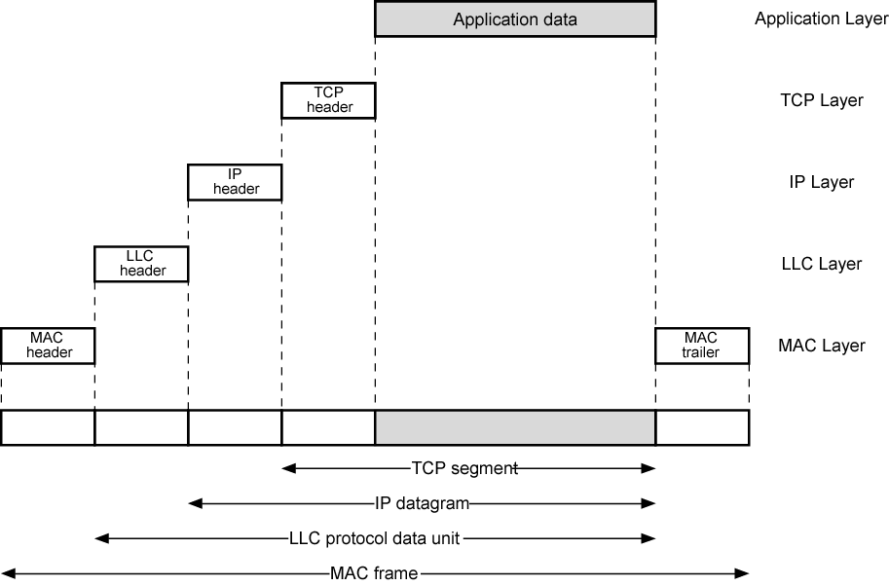
LAN Protocols in Context

Slide 29
Media Access Control
Where
  Central
    Greater control
    Simple access logic at station
    Avoids problems of co-ordination
    Single point of failure
    Potential bottleneck
  Distributed
How
  Synchronous
    Specific capacity dedicated to connection
  Asynchronous
    In response to demand

Slide 30
Asynchronous Systems
Round robin
  Good if many stations have data to transmit over extended period
Reservation
  Good for stream traffic
Contention
  Good for bursty traffic
  All stations contend for time
  Distributed
  Simple to implement
  Efficient under moderate load
  Tend to collapse under heavy load

Slide 31
MAC Frame Format
MAC layer receives data from LLC layer
MAC control
Destination MAC address
Source MAC address
LLS
CRC
MAC layer detects errors and discards frames
LLC optionally retransmits unsuccessful frames

Slide 32
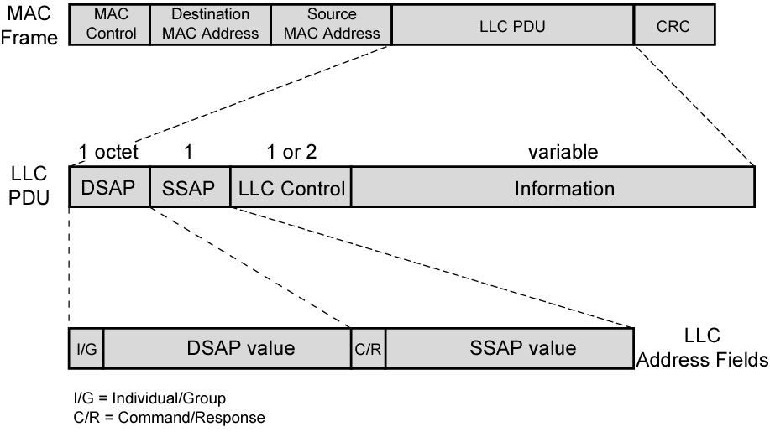
Generic MAC Frame Format

Slide 33
Bridges
Ability to expand beyond single LAN
Provide interconnection to other LANs/WANs
Use Bridge or router
Bridge is simpler
  Connects similar LANs
  Identical protocols for physical and link layers
  Minimal processing
Router more general purpose
  Interconnect various LANs and WANs
  see later

Slide 34
Why Bridge?
Reliability
Performance
Security
Geography

Slide 35
Functions of a Bridge
Read all frames transmitted on one LAN and accept those address to any station on the other LAN
Using MAC protocol for second LAN, retransmit each frame
Do the same the other way round

Slide 36
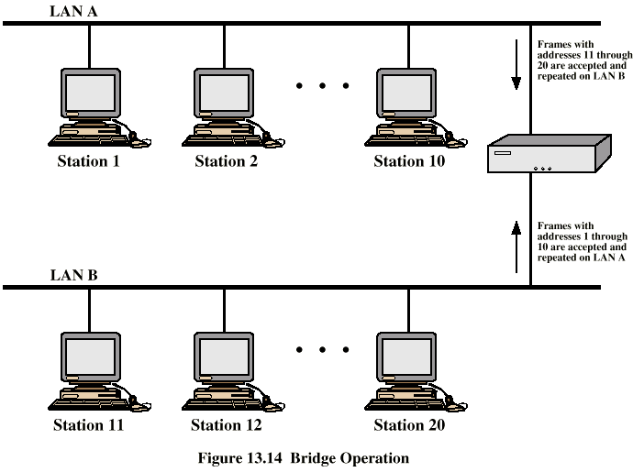
Bridge Operation

Slide 37
Bridge Design Aspects
No modification to content or format of frame
No encapsulation
Exact bitwise copy of frame
Minimal buffering to meet peak demand
Contains routing and address intelligence
  Must be able to tell which frames to pass
  May be more than one bridge to cross
May connect more than two LANs
Bridging is transparent to stations
  Appears to all stations on multiple LANs as if they are on one single LAN

Slide 38
Bridge Protocol Architecture
IEEE 802.1D
MAC level
  Station address is at this level
Bridge does not need LLC layer
  It is relaying MAC frames
Can pass frame over external comms system
  e.g. WAN link
  Capture frame
  Encapsulate it
  Forward it across link
  Remove encapsulation and forward over LAN link

Slide 39
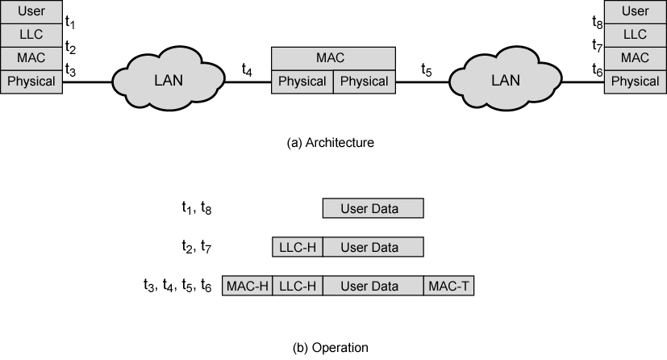
Connection of Two LANs

Slide 40
Fixed Routing
Complex large LANs need alternative routes
  Load balancing
  Fault tolerance
Bridge must decide whether to forward frame
Bridge must decide which LAN to forward frame on
Routing selected for each source-destination pair of LANs
  Done in configuration
  Usually least hop route
  Only changed when topology changes

Slide 41
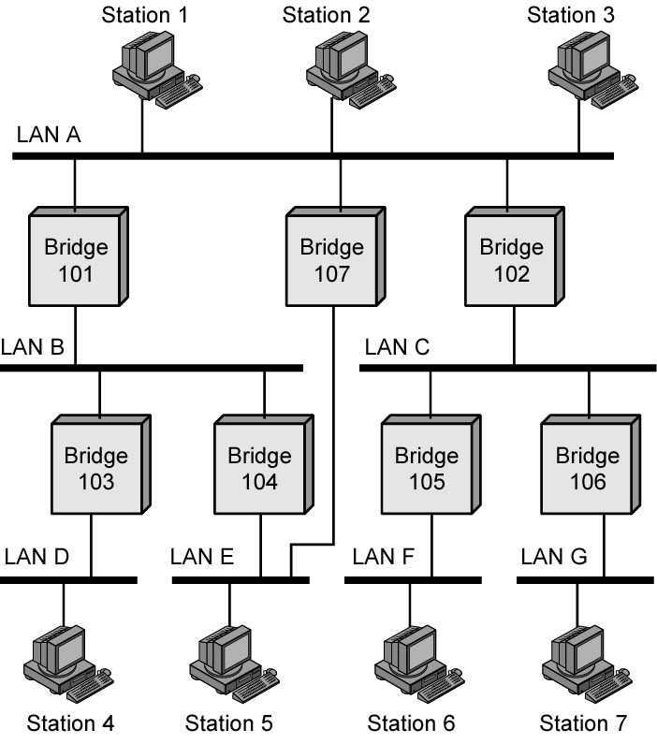
Bridges and
LANs with
Alternative
Routes

Slide 42
Spanning Tree
Bridge automatically develops routing table
Automatically update in response to changes
Frame forwarding
Address learning
Loop resolution

Slide 43
Frame forwarding
Maintain forwarding database for each port
  List station addresses reached through each port
For a frame arriving on port X:
  Search forwarding database to see if MAC address is listed for any port except X
  If address not found, forward to all ports except X
  If address listed for port Y, check port Y for blocking or forwarding state
    Blocking prevents port from receiving or transmitting
  If not blocked, transmit frame through port Y

Slide 44
Address Learning
Can preload forwarding database
Can be learned
When frame arrives at port X, it has come form the LAN attached to port X
Use the source address to update forwarding database for port X to include that address
Timer on each entry in database
Each time frame arrives, source address checked against forwarding database

Slide 45
Spanning Tree Algorithm
Address learning works for tree layout
  i.e. no closed loops
For any connected graph there is a spanning tree that maintains connectivity but contains no closed loops
Each bridge assigned unique identifier
Exchange between bridges to establish spanning tree

Slide 46
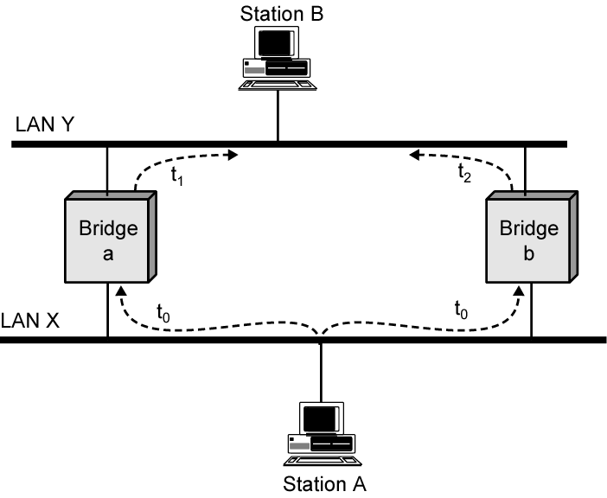
Loop of Bridges

Slide 47
Layer 2 and Layer 3 Switches
Now many types of devices for interconnecting LANs
Beyond bridges and routers
Layer 2 switches
Layer 3 switches

Slide 48
Hubs
Active central element of star layout
Each station connected to hub by two lines
  Transmit and receive
Hub acts as a repeater
When single station transmits, hub repeats signal on outgoing line to each station
Line consists of two unshielded twisted pairs
Limited to about 100 m
  High data rate and poor transmission qualities of UTP
Optical fiber may be used
  Max about 500 m
Physically star, logically bus
Transmission from any station received by all other stations
If two stations transmit at the same time, collision

Slide 49
Hub Layouts
Multiple levels of hubs cascaded
Each hub may have a mixture of stations and other hubs attached to from below
Fits well with building wiring practices
  Wiring closet on each floor
  Hub can be placed in each one
  Each hub services stations on its floor

Slide 50
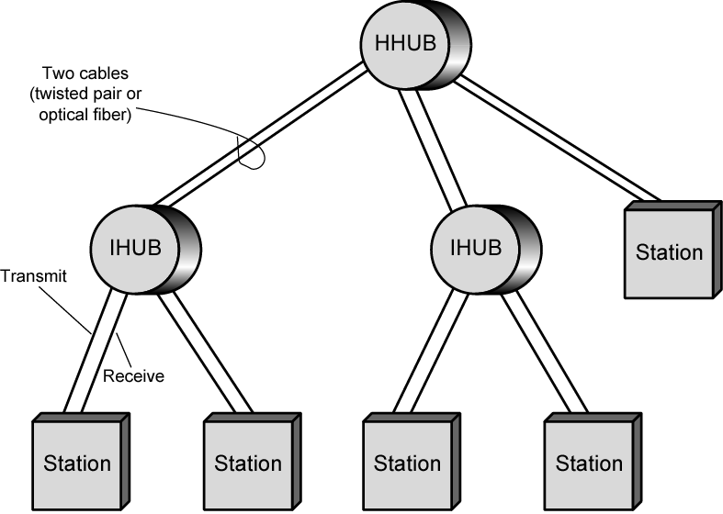
Two Level Star Topology

Slide 51
Buses and Hubs
Bus configuration
  All stations share capacity of bus (e.g. 10Mbps)
  Only one station transmitting at a time
Hub uses star wiring to attach stations to hub
  Transmission from any station received by hub and retransmitted on all outgoing lines
  Only one station can transmit at a time
  Total capacity of LAN is 10 Mbps
Improve performance with layer 2 switch

Slide 52
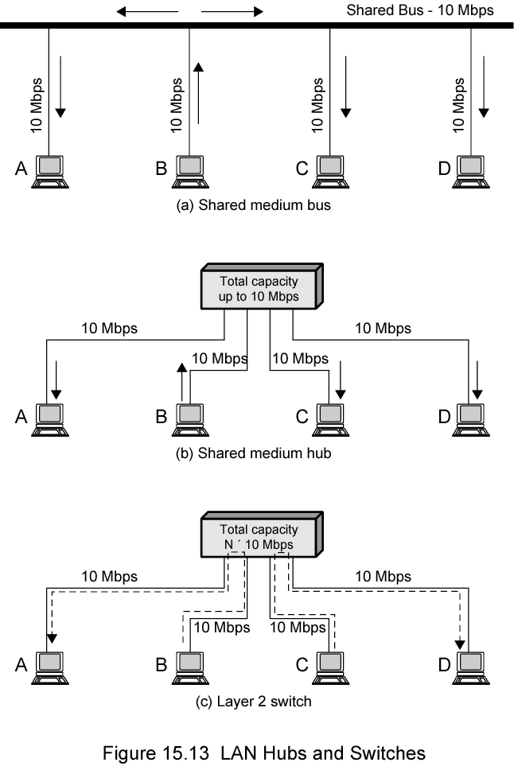
Shared Medium Bus and Hub

Slide 53
Shared Medium Hub and
Layer 2 Switch

Slide 54
Layer 2 Switches
Central hub acts as switch
Incoming frame from particular station switched to appropriate output line
Unused lines can switch other traffic
More than one station transmitting at a time
Multiplying capacity of LAN

Slide 55
Layer 2 Switch Benefits
No change to attached devices to convert bus LAN or hub LAN to switched LAN
For Ethernet LAN, each device uses Ethernet MAC protocol
Device has dedicated capacity equal to original LAN
  Assuming switch has sufficient capacity to keep up with all devices
  For example if switch can sustain throughput of 20 Mbps, each device appears to have dedicated capacity for either input or output of 10 Mbps
Layer 2 switch scales easily
  Additional devices attached to switch by increasing capacity of layer 2

Slide 56
Types of Layer 2 Switch
Store-and-forward switch
  Accepts frame on input line
  Buffers it briefly,
  Then routes it to appropriate output line
  Delay between sender and receiver
  Boosts integrity of network
Cut-through switch
  Takes advantage of destination address appearing at beginning of frame
  Switch begins repeating frame onto output line as soon as it recognizes destination address
  Highest possible throughput
  Risk of propagating bad frames
    Switch unable to check CRC prior to retransmission

Slide 57
Layer 2 Switch v Bridge
Layer 2 switch can be viewed as full-duplex hub
Can incorporate logic to function as multiport bridge
Bridge frame handling done in software
Switch performs address recognition and frame forwarding in hardware
Bridge only analyzes and forwards one frame at a time
Switch has multiple parallel data paths
  Can handle multiple frames at a time
Bridge uses store-and-forward operation
Switch can have cut-through operation
Bridge suffered commercially
  New installations typically include layer 2 switches with bridge functionality rather than bridges

Slide 58
Problems with Layer 2 Switches (1)
As number of devices in building grows, layer 2 switches reveal some inadequacies
Broadcast overload
Lack of multiple links
Set of devices and LANs connected by layer 2 switches have flat address space
  Allusers share common MAC broadcast address
  If any device issues broadcast frame, that frame is delivered to all devices attached to network connected by layer 2 switches and/or bridges
  In large network, broadcast frames can create big overhead
  Malfunctioning device can create broadcast storm
    Numerous broadcast frames clog network

Slide 59
Problems with Layer 2 Switches (2)
Current standards for bridge protocols dictate no closed loops
  Only one path between any two devices
  Impossible in standards-based implementation to provide multiple paths through multiple switches between devices
    Limits both performance and reliability.
Solution: break up network into subnetworks connected by routers
MAC broadcast frame limited to devices and switches contained in single subnetwork
IP-based routers employ sophisticated routing algorithms
  Allow use of multiple paths between subnetworks going through different routers

Slide 60
Problems with Routers
Routers do all IP-level processing in software
  High-speed LANs and high-performance layer 2 switches pump millions of packets per second
  Software-based router only able to handle well under a million packets per second
Solution: layer 3 switches
  Implementpacket-forwarding logic of router in hardware
Two categories
  Packet by packet
  Flow based

Slide 61
Packet by Packet or
Flow Based
Operates insame way as traditional router
Order of magnitude increase in performance compared to software-based router
Flow-based switch tries to enhance performance by identifying flows of IP packets
  Same source and destination
  Done by observing ongoing traffic or using a special flow label in packet header (IPv6)
  Once flow is identified, predefined route can be established

Slide 62
Typical Large LAN Organization
Thousands to tens of thousands of devices
Desktop systems links 10 Mbps to 100 Mbps
  Into layer 2 switch
Wireless LAN connectivity available for mobile users
Layer 3 switches at local network's core
  Form local backbone
  Interconnected at 1 Gbps
  Connect to layer 2 switches at 100 Mbps to 1 Gbps
Servers connect directly to layer 2 or layer 3 switches at 1 Gbps
Lower-cost software-based router provides WAN connection
Circles in diagram identify separate LAN subnetworks
MAC broadcast frame limited to own subnetwork

Slide 63
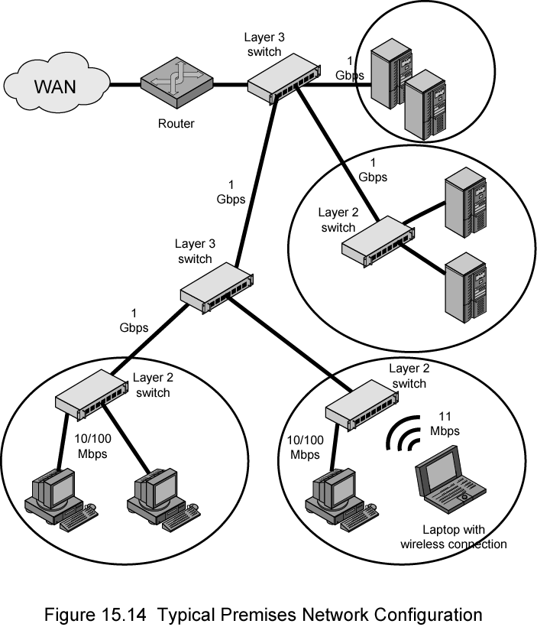
Typical
Large
LAN
Organization
Diagram

Slide 64
Required Reading
Stallings chapter 15
Loads of info on the Web

